Slide 1
Strategy Review and Business Plan
Yunfei Ma

Slide 2
Content
Strategy Overview
Philosophy
Portfolio
Book
Investment Process
Historical PnL measures
Track record
Technology

Slide 3
Strategy Overview
Key alpha drivers:
Relative values across
different types of products
different tenors
price deviation
Key beta followers:
Macros
Institutional behaviors
Instrument universe:
Fixed-income rates products
bonds
swaps
futures

Slide 4
Philosophy
Profit from macros and market inefficiencies
Directional speculation based on information from
Macros
Market microstructures
Order flows
Indirectional trade based on relative value using
Top-down approach to long cheap and short expensive
Cross-product
Cross-tenor
Curve arbitrage
Rigorous risk management

Slide 5
Main strategies for different scenarios
 |  | Expectation of economic growth
 |  | High | Low
Funding rate | High | 2022.10-2022.12, 2023.8-2023.10 no leveraging short bond with low carry and roll, long bond with high carry and roll swap hedging | 2023.10-2024.3, 2024.9-2024.12 low leveraging hold long duration bonds swap flattener
 | Low | 2023.1-2023.3 maximize leveraging long bond with high carry and roll swap steepener | 2022.6-2022.9, 2023.4-2023.7, 2024.4-2024.8, maximize leveraging long bonds with long duration

Slide 6
Portfolio: Investment process
Quantitative screening
Sector selection
Historical market data and curve pricing
Z-score derived from statistical analysis
Price-volume trends and distribution
Crosschecked by fundamentals
Repo rates and macro-economics
Institutional product/tenor preference
Market regime change

Slide 7
Portfolio: Track Record
Date | Return | Short-term Bond Fund Index | Long-term Bond Fund Index | Compound Bond Fund Index
2022-06-30 | 0.09% | 0.13% | 0.11% | 0.71%
2022-07-29 | 0.42% | 0.50% | 0.65% | 1.18%
2022-08-31 | 0.87% | 0.77% | 1.05% | 1.24%
2022-09-30 | 0.80% | 0.86% | 1.13% | 1.01%
2022-10-31 | 1.10% | 1.07% | 1.46% | 1.09%
2022-11-30 | 1.12% | 0.78% | 0.82% | 0.70%
2022-12-30 | 1.15% | 0.83% | 0.86% | 0.49%
2023-01-31 | 0.13% | 0.24% | 0.10% | 0.50%
2023-02-28 | 0.14% | 0.50% | 0.38% | 0.64%
2023-03-31 | 0.54% | 0.88% | 0.88% | 1.05%
2023-04-28 | 1.35% | 1.20% | 1.26% | 1.38%
2023-05-31 | 2.30% | 1.60% | 1.74% | 1.61%
2023-06-30 | 2.75% | 1.82% | 2.04% | 1.95%
2023-07-31 | 3.32% | 2.07% | 2.29% | 2.27%
2023-08-31 | 3.45% | 2.38% | 2.71% | 2.38%
2023-09-28 | 3.40% | 2.40% | 2.61% | 2.20%
2023-10-31 | 3.49% | 2.57% | 2.71% | 2.10%
2023-11-30 | 4.01% | 2.78% | 2.93% | 2.25%
2023-12-31 | 4.90% | 3.21% | 3.55% | 2.75%
2024-01-31 | 1.39% | 0.37% | 0.50% | -0.13%
2024-02-29 | 2.80% | 0.74% | 1.02% | 0.76%
2024-03-29 | 3.28% | 0.90% | 1.21% | 1.00%
2024-04-30 | 3.40% | 1.19% | 1.55% | 1.48%
2024-05-30 | 4.20% | 1.45% | 1.92% | 1.89%
2024-05-31 | 4.19% | 1.46% | 1.93% | 1.88%
2024-06-28 | 5.14% | 1.72% | 2.39% | 2.08%
2024-07-31 | 5.80% | 2.00% | 2.83% | 2.29%
2024-08-30 | 5.96% | 1.99% | 2.77% | 2.00%
2024-09-30 | 6.21% | 1.98% | 2.72% | 2.66%
2024-10-30 | 6.71% | 2.10% | 2.87% | 2.76%
2024-11-29 | 7.90% | 2.47% | 3.51% | 3.46%
2024-12-31 | 10.45% | 3.01% | 4.60% | 4.48%
 | 2022/6/1-2022/12/31 | 2023/1/1-2023/12/31 | 2024/1/1-2023/12/31
Size | 3000M | 5000M | 5000M
total | 592M | 245M | 522M
annual return | 3.38% | 4.90% | 10.45%
volatility | 0.65% | 1.08% | 2.33%
Risk Free Rate | 1.79% | 2.17% | 1.96%
Sharpe Ratio | 2.47 | 2.54 | 3.65
MDD | -0.14% | -0.55% | -0.76%
Currency unit in CNY
Max leveraging ratio is 2.0

Slide 8
Portfolio: Book Composition
 | Main Strategy | Secondary Strategy | Tertiary Strategy
Key strategies | Directional, Select sector and construct base portfolio | Indirectional, Buy and sell bonds based on relative values | Indirectional, Construct flattener/steepener/butterfly using bonds and/or swaps
Volume and Percentage of capital used | Average 75% | Based on strategy 1 | Single side max 20%
Key pnl drivers | Market beta | Alphas from curve pricing, market inefficiencies | Macros and statistics
Risk limit | DV01 5M | Based on strategy 1 | 1M/side/trade
Holding period | Monthly | Less than a week | weeks

Slide 9
Technology
Category | Item | Function | Techniques
Existing resources (self-designed and transferable) | Web Viewer | Historical time series analysis | python dash module
 | Excel Spreadsheet | Real time data monitor, RV, hedging ratio z-score, carry, roll, etc. | python scripts and VBA
 | Pricing libraries and basic backtesting | Curve pricing, statistical analysis and calibration | Python, based on no-arbitrage affine models
New needs | Data | Cleaned historical and real time data | High-efficient database processing language
 | Backtesting framework | Evaluate strategies and computing parameters | Parallel computing
 | Trade execution | spread/butterfly order placement | OMS, EMS
 | Trading assistant | Sending and checking orders
 | Funding support | Managing leveraging and collaterals

Slide 10
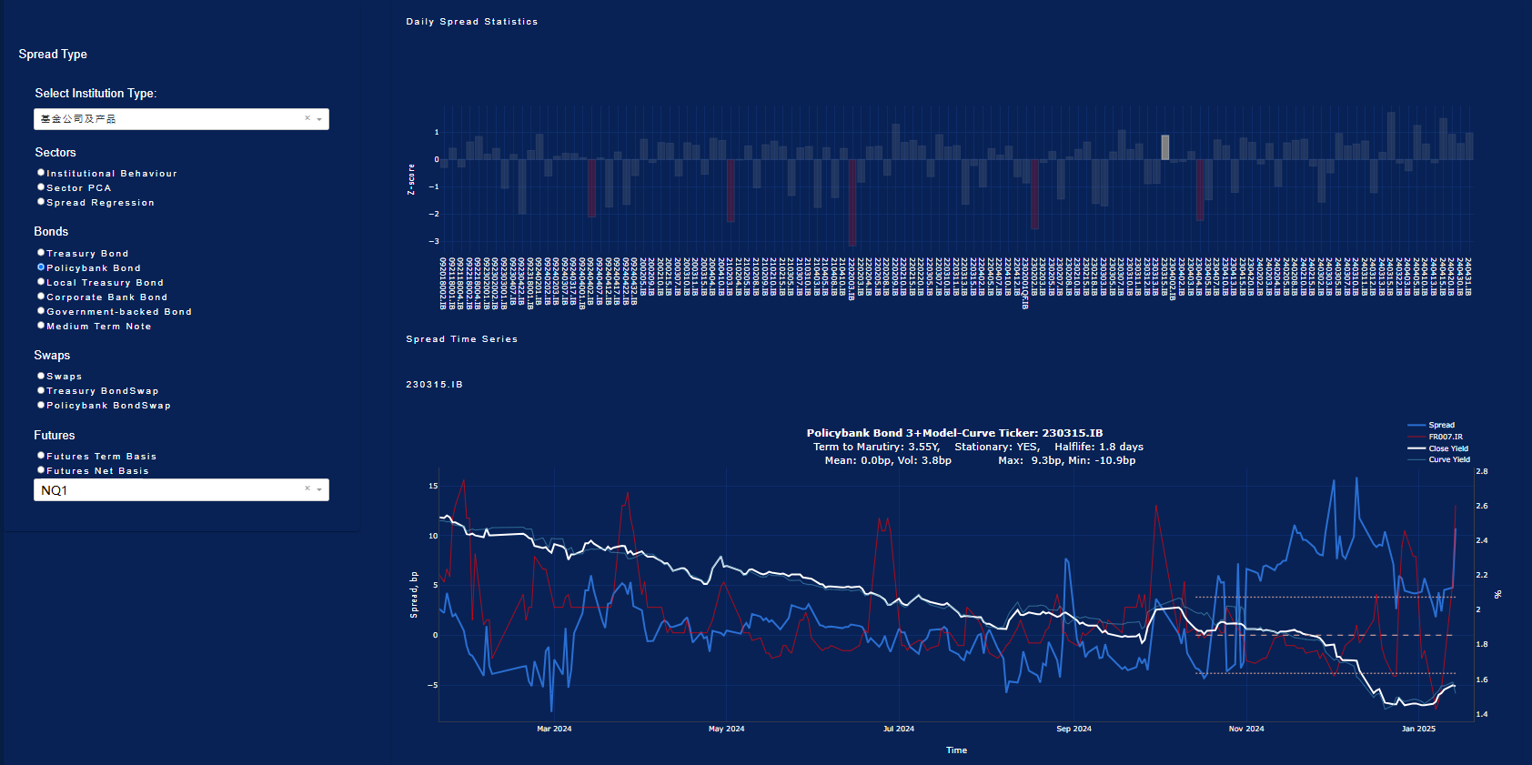
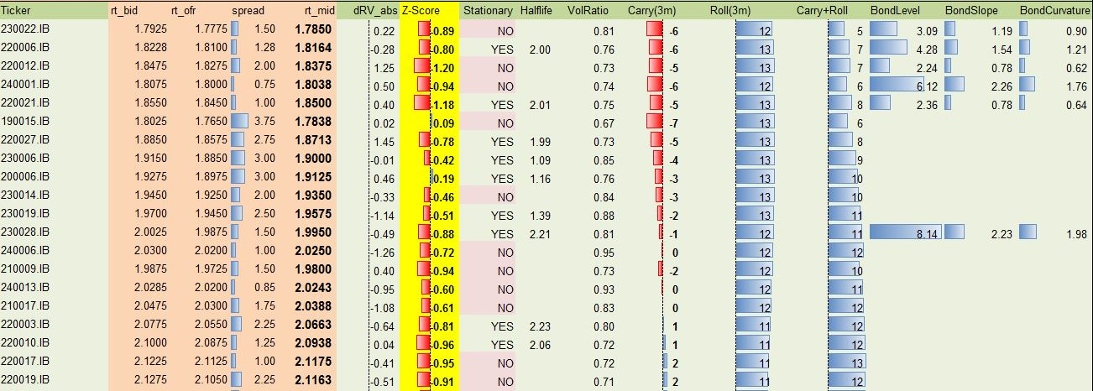
Self-developed tools
Curve generation based on affine models
Forward curve adjustment tools based market views
Statistical analysis tools for
sector selection
security selection
Bond-futures basis monitor
Order flow analysis tools

